Slide 1

INSTITUTE :UIE
DEPARTMENT: ALL ACADEMIC UNITS
Bachelor of Engineering (All Sections)
Subject Name and Code:
Engineering Physics 23SPH-141
Prepared by: Anu Kapoor, Assistant Prof. Physics
LASER
DISCOVER . LEARN . EMPOWER

Slide 2
COURSE OBJECTIVES
The course is designed to make the students industry ready to contribute in the growing demand of the industry at local, national and international level.
It will make the students competent to understand basic concepts and applications of advanced engineering physics and apply its principles in their respective fields at global platform.
It will enhance the skill level of the students and shall make them preferred choice for getting employment in industry and research labs.
It will give thorough knowledge of the discipline to enable students to disseminate knowledge in pursuing excellence in academic areas.

Slide 3
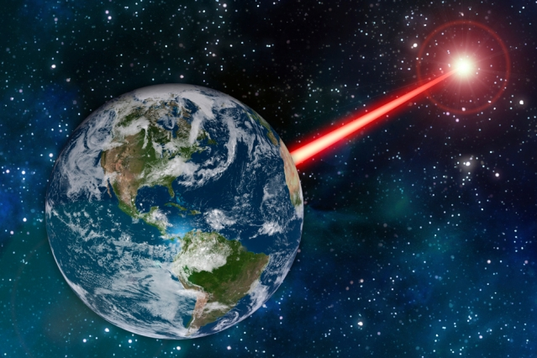
COURSE OUTCOMES
CO Number | Title On completion of this course, the students are expected to learn | Level
CO1 | Quote the basic fundamental concepts of lasers, optical fibres, crystallography, ultrasonic oscillations, semiconductor physics, quantum mechanics and nanotechnology. | Remember, Understand
CO2 | Demonstrate the working of various lasers, fibre components, semiconductor devices; explain the behaviour of crystalline solids, quantum and nano-scale systems. | Understand
CO3 | Solve problems by applying principles related to lasers, fibres, semiconductors, oscillations, quantum and nanoscience. | Applying
CO4 | Compare various lasers and fibres, semiconducting devices, crystalline materials, structures at quantum and nanoscale on the basis of their properties for industrial applications. | Analyze
CO5 | Develop various systems using lasers, fibres, semiconductors and nanomaterials for futuristic applications. | Design
Fig. 1 Introduction [1]

Slide 4

“ In the War of Worlds, written before the turn of 20th century, HG Wells told a fanciful story of how Martians invaded and almost conquered the earth. Their weapon was a mysterious sword of heat, from which flickered a ghost of a beam of light. It felled men in their tracks, made lead run like water and flashed anything combustible into masses of flame. Today Well’s word of heat comes close to reality in the laser…………”
Fig. 2 Introduction [2]

Slide 5

WHY TO STUDY LASER
Offering a high-speed way to process various materials, lasers are being used on a large scale in various industries.
Innovative technologies are driving the growth of industrial lasers. Manufacturers are introducing technologically advanced industrial lasers for various applications.
The global industrial laser market is highly dynamic, and growing at a fast pace.
The increasing innovations taking place in fiber lasers play an important role in the growth of the global industrial laser market
https://www.youtube.com/watch?v=_yLfLDHBUak[3]

Slide 6
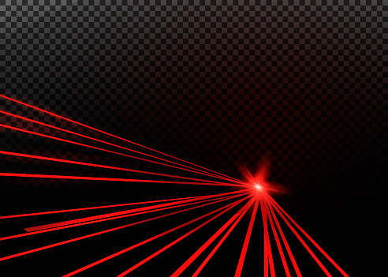
CONTENT TO BE DISCUSSED….
Holography
Applications
Fig. 3 Introduction [4]

Slide 7
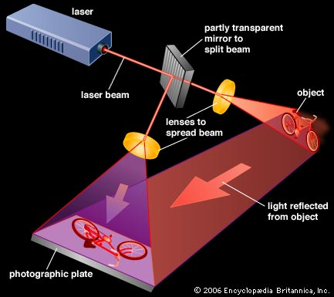
HOLOGRAPHY
Producing 3D image of an object is known as holography
Two step process
Recording of hologram
Reconstruction of image
Fig. 4 Holography [5]

Slide 8
HOLOGRAPHY
“Holography from the Greek, whole+ write) is the science of producing holograms”
It is an advanced form of photography that allows an image to be recorded in three dimensions
“Holography is a method of producing a visual three-dimensional (3-D) image of an object by means of light wave patterns recorded on a photographic plate.”
Dennis Gabor…Father of holography

Slide 9
HOLOGRAM
HOLOGRAM: Photograph of an interference pattern which, when suitably illuminated by laser light, produces a three-dimensional image.
If you look at these holograms from different angles, you see objects from different perspectives, just like you would if you were looking at a real object
It shows Divisible property i.e If you cut one in half, each half contains whole views of the entire holographic image

Slide 10
HOLOGRAM
HOW TO CREATE A HOLOGRAM
To create a hologram, a laser beam (coherent light) is split in two beams :
Reference beam: that stays undisturbed
Object beam: strikes the object and then bounces onto the plate
Working of holography is divided into two phases:
Recording
Reconstruction

Slide 11
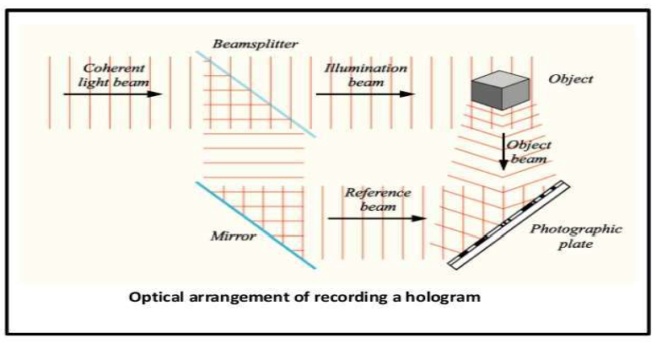
RECORDING OF HOLOGRAM
Fig. 5 Recording of hologram [6]

Slide 12
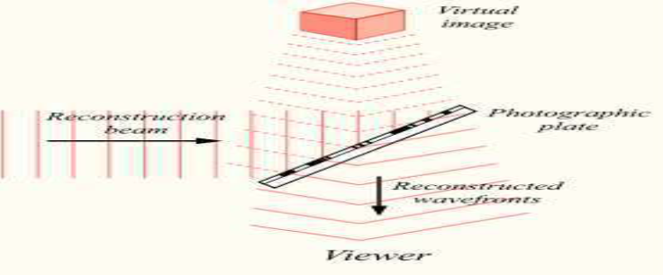
RECONSTRUCTION OF IMAGE
When a hologram is later illuminated with coherent light of the same frequency that created it, a three-dimensional image of the subject appears.
Fig. 6 Reconstruction of image [6]

Slide 13
APPLICATIONS OF HOLOGRAPHY
3-D Photography
Bio-medical Applications
Compact disk
Grocery store
Holographic Interferometery
Holographic Scanners
Holostores

Slide 14
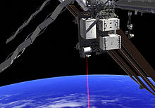
APPLICATIONS OF LASER
Lasers in communication:
In optical fiber communication laser bandwidth is very high compared to the radio and microwave communications.
As it has large bandwidth, more amount of data can be sent.
More channels can be simultaneously transmitted.
Lasers are also used in other communication devices, including high speed photo copiers and printers
Fig. 7 Applications [7]

Slide 15
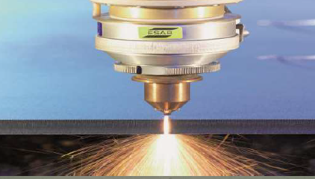
APPLICATIONS OF LASER
Lasers in industry:
Lasers can be used to blast holes in diamonds and hard steel.
Lasers can cut, drill, weld, remove metal from surfaces and perform these operations even at surfaces inaccessible by mechanical methods.
Lasers range finder is used to measure distance to making maps by surveyors.
Fig. 8 Applications [8]

Slide 16
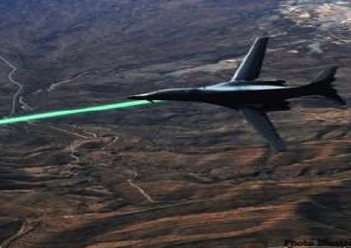
APPLICATIONS OF LASER
Lasers in military:
A laser beam can be bounced off a target such as enemy air plane or ship, to determine its distance and speed.
Laser can serve as a war weapon.
High energy lasers are being employed to destroy enemy air crafts and missiles.
Fig. 9 Applications [9]

Slide 17
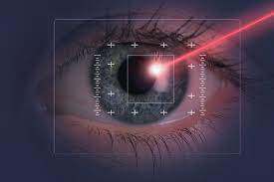
APPLICATIONS OF LASER
Lasers in medical field:
The laser can also repair a detached retina
The laser is very useful in removing extraneous blood
Laser is used in destruction of tumours
Laser is used in bloodless surgeries.
Laser is used in laser angioplasty.
Fig. 10 Applications [10]

Slide 18
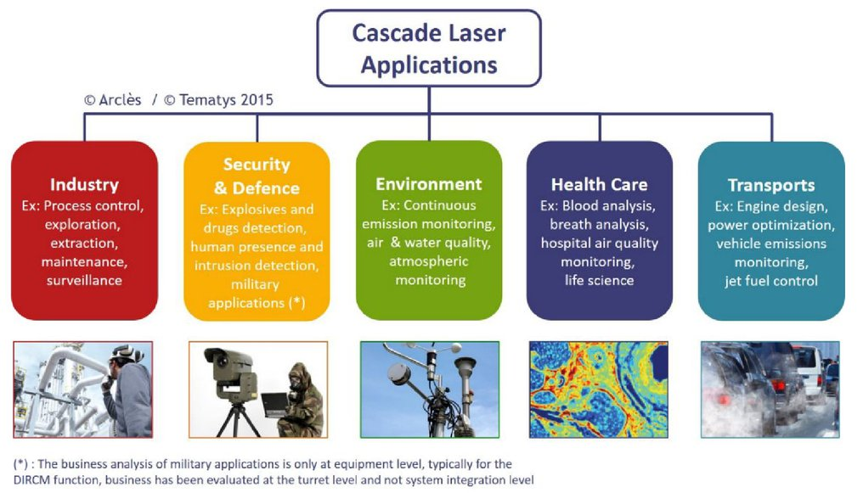
ADVANCES IN LASER APPLICATIONS

Slide 19
SUMMARY
Holography
Steps to record hologram
Applications of laser in different fields

Slide 20
REFERENCES
[1] http://news.mit.edu/2018/laser-attract-alien-astronomers-study-1105
[2] https://www.gutenberg.org/files/36/36-h/36-h.htm
[3] https://www.youtube.com/watch?v=_yLfLDHBUak
[4] stockphoto.com/in/vector/abstract-red-laser-beam-transparent-isolated-on-black-background-vector-illustration-gm1048453908-280444377
[5] https://kids.britannica.com/kids/article/hologram/399502
[6] http://zidzap.weebly.com/edu/archives/10-2014
[7] https://tematys.fr/WordPress3/tematys-new-release-cascade-laser-components-systems-technology-and-market-trends/
[8] Laud B.B., Laser and Non -Linear Optics, Edition 1st, (1991), Wiley Eastern Ltd.
[9] Beiser A, Concepts of Modern Physics,Edition 6th, (2003),Tata Mcgraw Hill, Noida.
[10] Bhattacharya D. K., Tandon Poonam, Engineering Physics.,Edition 1st , (2015), Oxford.
[11] Ghatak A. (2012) Optics, McGraw Hill Education. ISBN: 978-1259004346.

Slide 21
THANK YOU
anukapoor.appsci@cumail.in

